Slide 1
Description Logic
OPTIMISING TABLEAUX DECISION
PROCEDURES FOR DESCRIPTION
LOGICS
Ian R. Horrocks, 1997
University of Manchester

Slide 2
The approach:
unfold,
normalize,
prove

Slide 3
Tableaux algorithm
The goal of the tableaux algorithm is to try to construct a model of the formula:
  If a model cannot be constructed, the subsumption holds

Slide 4
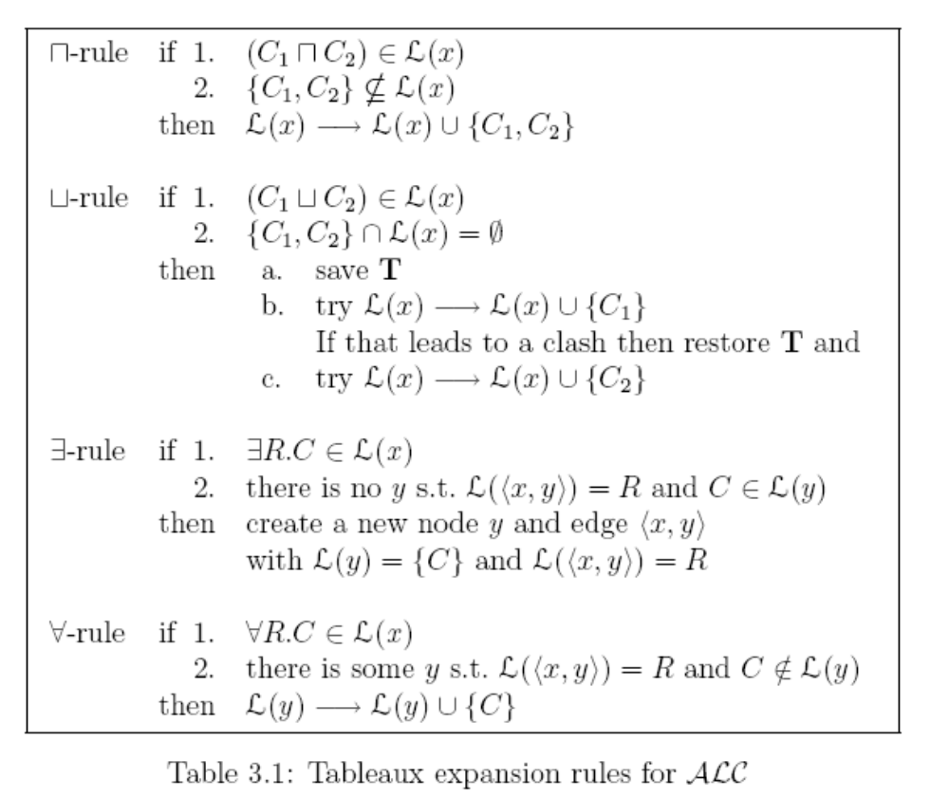

Slide 5
Examples subsumption (Page 49 thesis)
Vegan := Person ∏ ∀ eats.plant
Vegetarian := Person ∏ ∀ eats.(plant Ц dairy )
Show that vegan ⊑ vegetarian by demonstrating that
vegan ∏ ¬vegetarian is not satisfiable.
1. Unfold and normalize vegan ∏ ¬vegetarian
  Person ∏ ∀ eats. plant ∏ (¬ person Ц ∃eats.(¬ plant ∏ ¬ dairy))
2. Initialize T to contain a single not x labelled
  L(x) = {Person ∏ ∀ eats.plant ∏ (¬ person Ц ∃ eats.( plant ∏ ¬ dairy))}

Slide 6
3. Apply ∏ rule to Person ∏ ∀ eats.plant ∏ (¬ person Ц ∃ eats.( plant ∏ ¬ dairy)) Є L(x)
  L(x) → L(x) U {Person , ∀ eats.plant , (¬ person Ц ∃ eats.( plant ∏ ¬ dairy)) }
4. Apply the Ц rule to ¬ person Ц ∃eats.( plant ∏ ¬ dairy)) } Є L(x)
  (a) save T and try
  L(x) → L(x) U {¬ person }
    This is an obvious contradiction as { person , ¬ person }
  (b) restore T and try L(x) → L(x) U { ∃eats. (¬plant ∏ ¬dairy }

Slide 7
5. Apply the ∃ rule to ∃eats. (¬plant ∏ ¬dairy) Є L(x)
  Create a new node y and a new edge <x,y>
  L(y) = {¬plant ∏ ¬dairy) }
  L(<x,y>) = eats
6. Apply the ∀ rule to ∀eats.plant Є L(x) and L(<x,y>) = eats
  L(y) → L(y) U {plant}
7. Apply the ∏ rule to ¬plant ∏ ¬dairy Є L(x)
  L(y) → L(y) U {¬plant , ¬dairy }
  This is obvious contradiction as {plant, ¬plant } ⊑ L(y)
As all possible application of union rule leads to contradiction. Vegan ∏ ¬ vegetarian is unsatisfiable and thus vegetarian subsumes vegan.

Slide 8
Unfold and normalize
  Person ∏ ∀eats. plant ∏ (¬person Ц ∃eats.(¬plant ∏ ¬dairy))
AND
  Person , ∀eats.plant , (¬person Ц ∃eats.(¬plant ∏ ¬dairy)
Or
Person , ∀ eats.plant
¬ person
Or
Person , ∀ eats.plant
  ∃ eats.(¬ plant ∏ ¬ dairy
∃
Person , ∀ eats.plant
L(y) → {¬ plant ∏ ¬ dairy}
L(x,y) → eats
∀
L(x) → Person
L(y) →plant
L(x,y) → eats
L(y) → ¬ plant ∏ ¬ dairy
AND
L(y) → ¬ plant , ¬ dairy

Slide 9
Example non subsumption
Conversely it can be shown that vegetarian ⊄ vegan by demonstrating that vegetarian ∏ ¬ vegan is satisfiable
Vegan := Person ∏ ∀ eats.plant
Vegetarian := Person ∏ ∀ eats.(plant Ц dairy )
1. Unfold and normalise vegetarian ∏ ¬ vegan
  Person ∏ ∀ eats.(plant Ц dairy ) ∏ (¬person Ц ∃eats. ¬ plant)
2. Initialize T to contain a single node x labeled
  L(x) = {Person ∏ ∀ eats.(plant Ц dairy ) ∏ (¬person Ц ∃eats. ¬ plant)}

Slide 10
3. Apply ∏ rule to Person ∏ ∀ eats.(plant Ц dairy) ∏ (¬person Ц ∃eats. ¬ plant)} Є L(x)
L(x) → L(x) U {Person, ∀ eats.plant Ц dairy) , (¬person Ц ∃eats. ¬ plant)}
4. Apply the Ц rule to ¬person Ц ∃eats. ¬ plant Є L(x)
  (a) save T and try
  L(x) → L(x) U {¬ person }
    This is an obvious contradiction as { person , ¬ person }
  (b) restore T and try
    L(x) → L(x) U { ∃eats. ¬plant)

Slide 11
5. Apply the ∃ rule to ∃eats. ¬ plant Є L(x)
  Create a new node y and a new edge <x,y>
  L(y) = {¬ plant }
  L(<x,y>) = eats
6. Apply the ∀ rule to ∀ eats.(plant Ц dairy) Є L(x) and L(<x,y>) = eats
  L(y) → L(y) U {plant Ц dairy}
7. Apply the Ц rule to plant Ц dairy Є L(x)
  (a) save T and try
  L(y) → L(y) U {plant }
    This is an obvious contradiction as { plant , ¬ plant } Є L(y)
  (b) restore T and try
    L(y) → L(y) U { dairy)
Finally expanded . vegetarian ∏ ¬ vegan is satisfiable, thus vegan does not subsume vegetarian.

Slide 12
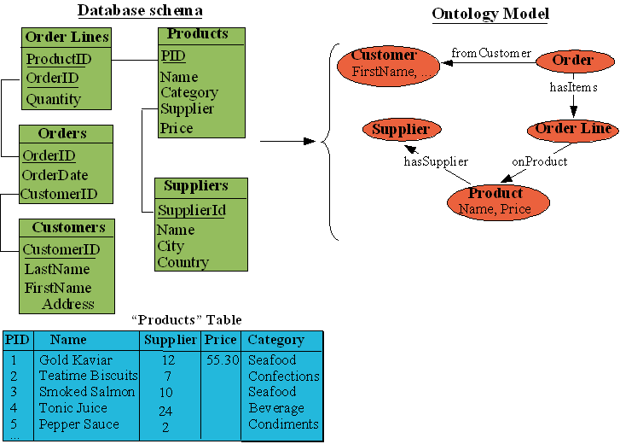
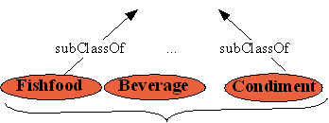
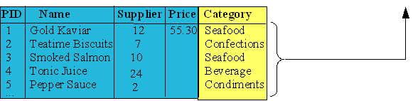
A motivating example
Typical mappings
covered by
several methods
Specific to
RTAXON

Slide 13
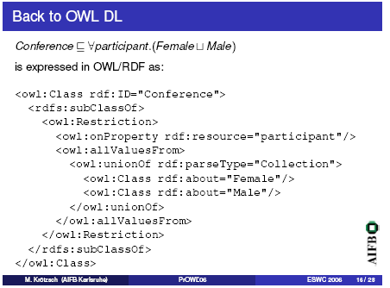

Slide 14
Select name, age from employee where salary > 20k.
Select name from employee where salary>25k.

Slide 15
attributes
Qu ⊑ Qs Qu ∏ ¬ Qs
Age ∏ ¬ (name ∏ age)
Age ∏ (¬ name Ц ¬age)
Age , (¬ name Ц ¬age)
Age , ¬ name
Age , ¬age
complete
clash

Slide 16
relations
Qu ⊑ Qs Qu ∏ ¬ Qs
employee ∏ ¬ (employee)
Employee, ¬ employee)
clash

Slide 17
relations
Qu ⊑ Qs Qu ∏ ¬ Qs
>25k.salary ∏ ¬ (>20k.salary)
>25K.salary, ¬ <=20K.salary)
clash

Slide 20
Example (Multiple Relation With Relationships)
Student
dept
course
number
Enrolled
Registered
Course
Student
course
year
Entity Relationship Diagram

Slide 21
Query Reasoning
Sn | Attributes Sa | Relation Sr | Predicate Sp
V1 | student ∩ number ∩ year | Registered ∩ Course | >= 500 number ∩ >= 1992
Cached Description
Sn | Attributes Qa | Relation Qr | Predicate Qp
Qu | student ∩ department | Enrolled ∩ Registered ∩ Course | >= 300 number ∩ >= 1995
User Query (Description)

Slide 22
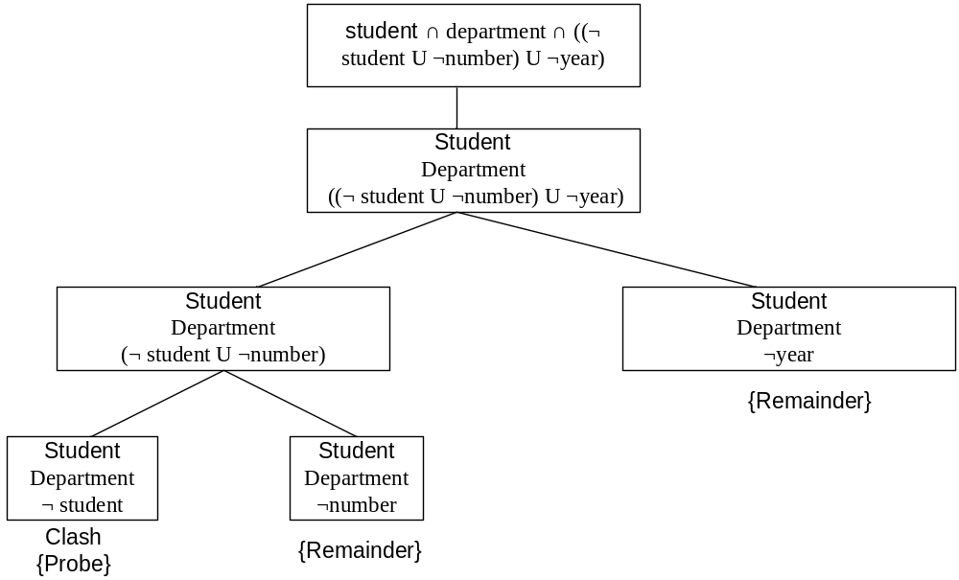
Sa ╞ Qa
department

Slide 23
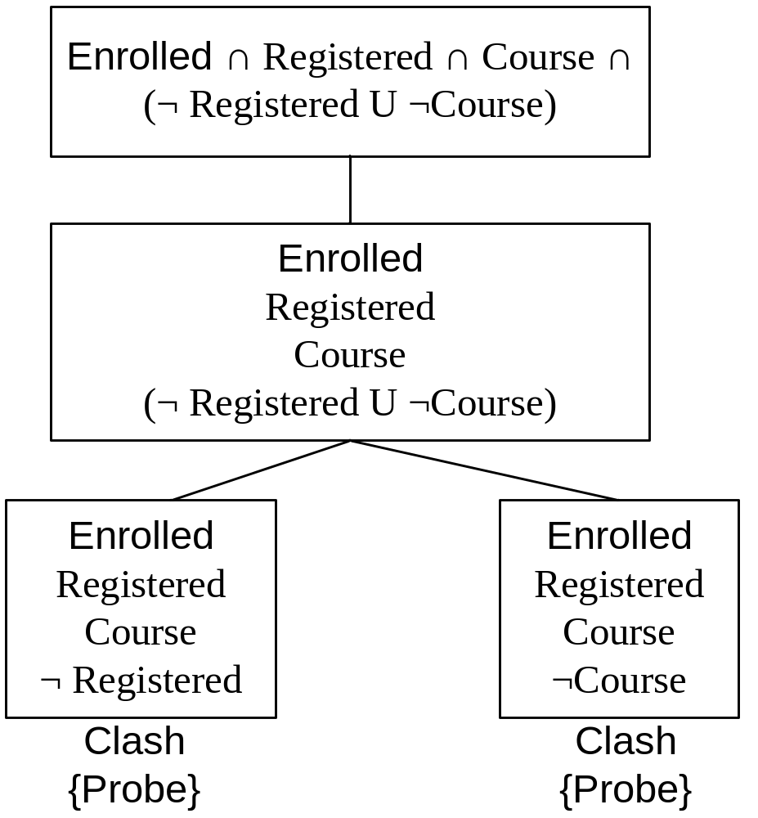
Sr ╞ Qr
enrolled

Slide 24
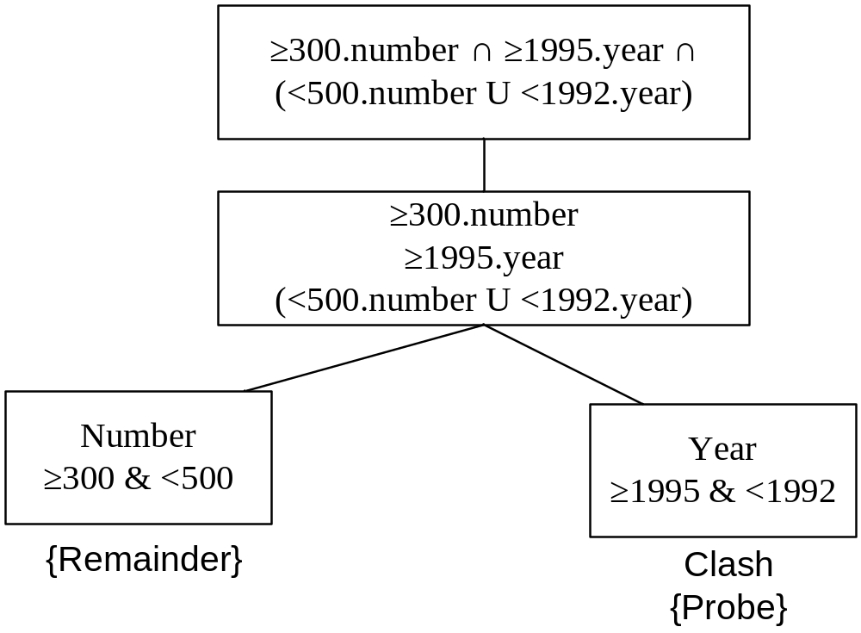
Sp ╞ Qp

